Slide 1
First Aid Basics

Slide 2
Objectives
To understand basic first aid procedures.
To identify emergency action steps.
To identify ways to respond to accidental and deliberate injuries.
To examine the appropriate way to respond to emergencies.
To demonstrate cardiopulmonary resuscitation procedures.

Slide 3
Main Menu
Introduction to First Aid
First Aid Techniques
Emergency Responses

Slide 4
First Aid Basics – Introduction to First Aid

Slide 5
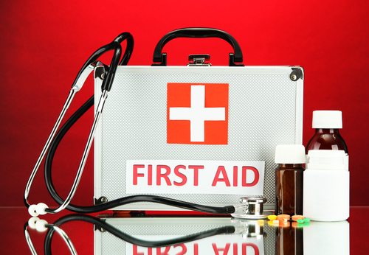
First Aid
Is the initial care given for an illness or injury
Is the help given until full medical treatment is available

Slide 6
First Aid Kits
Contain supplies needed for basic first aid
Can include supplies such as:
  medications
    fever reducing medication (e.g. acetaminophen, ibuprofen)
    cough suppressants or decongestant
    itch-reducing cream (e.g. calamine lotion, one percent hydrocortisone ointment) for rashes or bug bites
    antibiotic ointment for cleaning wounds
    self-injectable epinephrine for anaphylactic shock

Slide 7
First Aid Kits
Can include:
  bandaging materials
    bandages of assorted sizes
    butterfly bandages for small deep wounds
    elastic wraps to hold gauze or cold/hot packs in place
    gauze in rolls and two inch and four-inch pads
    adhesive tape
    sharp scissors with rounded tips

Slide 8
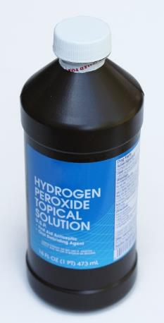
First Aid Kits
Can include:
  medical tools
    hydrogen peroxide
    accurate measuring device
    for liquid medicines
    thermometer (oral, rectal,
    electronic ear, or forehead
    thermometers)
    petroleum jelly

Slide 9
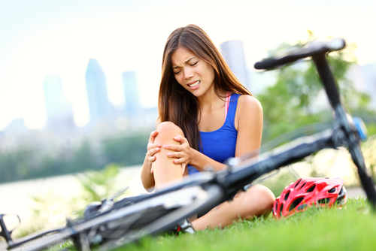
Types of Injuries
Include:
  accidental
    happens without cause
  deliberate
    happens with cause

Slide 10
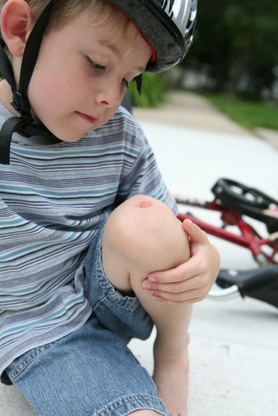
Common Injuries
Include:
  cuts and scrapes
  puncture wounds
  poisoning
  burns
  sprains
  strains
  heat-related injuries
  allergic reactions

Slide 11
Emergency Action Steps
Include the following:
  Step 1: Check
    “Hey Michael, are you okay?”
  Step 2: Call
    “911 – we have an emergency!”
  Step 3: Care
    “Stay with me Michael, help will be here soon.”

Slide 12
Emergency Action Steps
CHECK
  the situation and surroundings before approaching because danger might still be lurking
    hot wires, cables, spilled chemicals
  the victim for consciousness, pulse,
  breathing, skin coloring and appearance

Slide 13
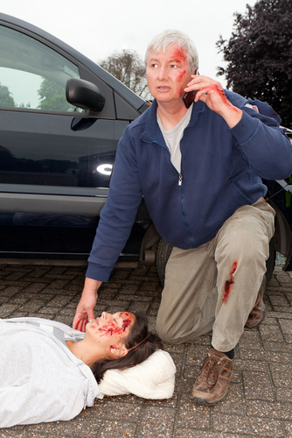
Emergency Action Steps
CALL
  for help— 911 or local
  emergency number
  others around you for help
  because there are many
  things others can do
    wait for emergency
    personnel to direct them
    to an accident
    find anything needed
      clean cloth, water, first aid kit

Slide 14

Emergency Action Steps
CARE
  for the victim
    attend to their needs; keep talking to and comforting victim until help arrives
    provide any first aid assistance you can
      keep victim still and do not move them
    perform CPR until help arrives if victim is unconscious and pulse and signs of breathing are not found

Slide 15
First Aid Basics – First Aid Techniques

Slide 16
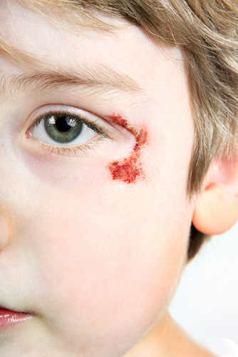
Cuts & Scrapes
Are damages to the surface of the skin
Only require emergency medical attention when:
  a cut is deep enough to reach bone
  skin loss is severe
  bleeding continues after
  ten minutes of pressure

Slide 17
Assessing Cuts & Scrapes
Involves checking the depth and length of cut
  cuts deeper than the first layer of skin may need stitches
  delaying stitches can cause an increased risk of infection

Slide 18
Assessing Cuts & Scrapes
Involves determining if the wounded individual has any health problems requiring professional medical attention
  for example: diabetes, cancer or medication suppressing the immune system

Slide 19
Immediate Treatment
For scrapes and cuts involves:
  applying pressure to excessive bleeding with clean cloth
  gently cleaning the cut area with soap and water after bleeding has subsided
    do not use hydrogen peroxide, alcohol or iodine solutions, which can prevent healing
  applying a topical first aid ointment such as Neosporin®
    soothes pain and helps reduce risk of infection

Slide 20
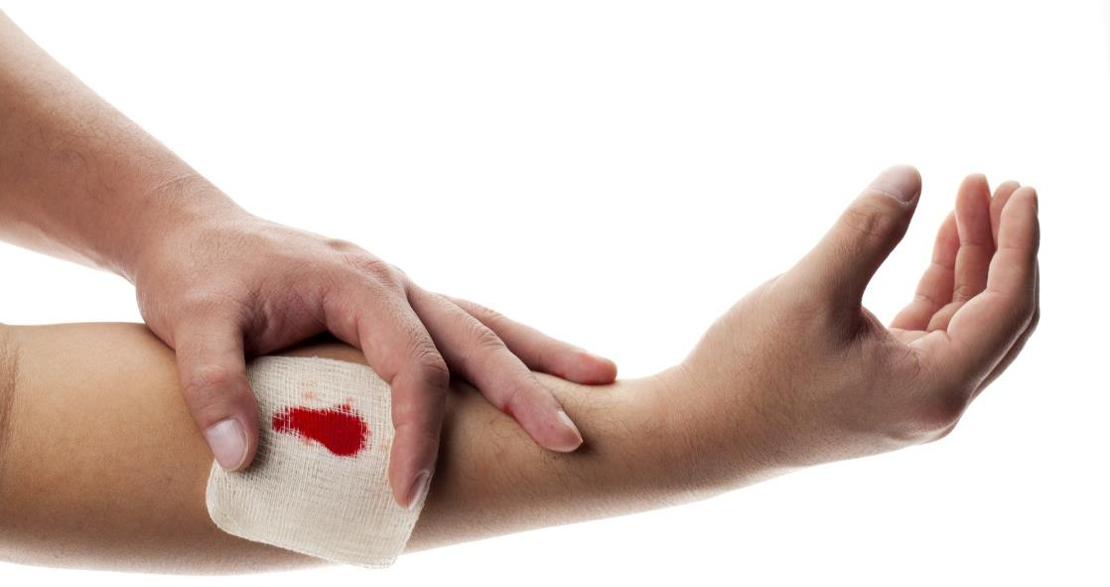
Immediate Treatment
For cuts and scrapes involves:
  placing a bandage over the wound after the area is clean and dry
    helps reduce the risk of infection

Slide 21
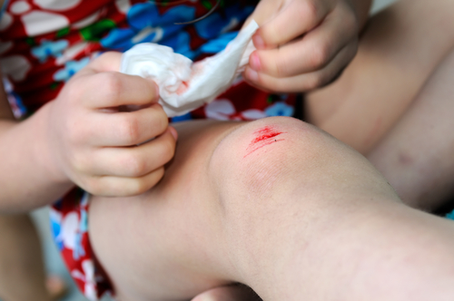
Long-Term Treatment
For cuts and scrapes involves:
  cleaning wounded area gently with soap and water daily
  changing bandage often

Slide 22
Immediate Treatment
For severe bleeding or hemorrhages involves:
  remove dirt or debris surrounding or on the wound
    do not remove embedded particles
    if large objects are embedded in the wound, do NOT apply pressure
First Aid Awareness: If organs have been displaced, do NOT reposition them or apply pressure to them. Displaced organs should be covered with a clean dressing until seen by a doctor.

Slide 23
Immediate Treatment
For severe bleeding or hemorrhages involves:
  control the bleeding by placing a sterile bandage or cloth on the wound
    applying firm pressure directly to the wound will help control the bleeding
    pressure can be maintained by tightly wrapping the wound with a bandage
    once pressure is applied and bleeding is being controlled, elevate the injured body part above the level of the heart

Slide 24
Immediate Treatment
For severe bleeding or hemorrhages involves:
  have the injured person lie down
  do NOT remove any of the bandaging
    if the wound bleeds through the bandaging, add another bandage on top of it, applying pressure
  once the bleeding has stopped, immobilize the injured body part until a doctor is able to assess the injury
Tourniquet: medical device which is useful for controlling bleeding from a limb, such as an arm or leg

Slide 25
Signs of Internal Bleeding
Include:
  bleeding from a body opening
    nose, mouth, ear, anus
  vomiting or coughing up blood
  bruising
  tender and distended stomach
  shock
    rapid, weak pulse
    rapid breathing
    decreased alertness
First Aid Awareness: If someone is demonstrating signs of internal bleeding, they should be seen by a doctor as soon as possible.

Slide 26
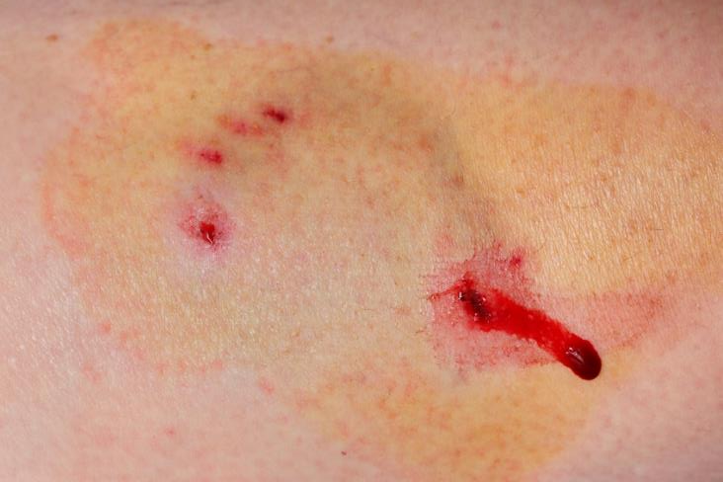
Puncture Wounds
Are caused by sharp objects forced into the skin
Seem to heal quickly, but infection is the real danger

Slide 27
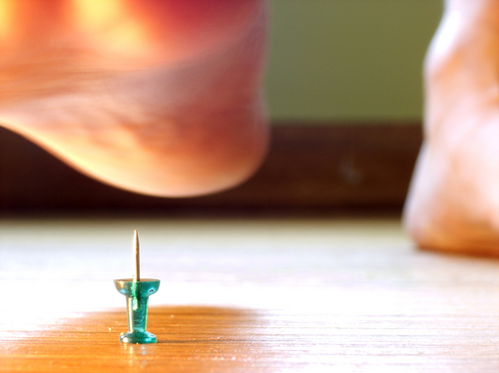
Assessing Puncture Wounds
Involves identifying impaled object
  if object has penetrated deeply, do not remove and seek medical attention immediately
Involves determining if the wounded individual has any health problems requiring medical
attention
  for example:
  diabetes, cancer or
  a suppressed
  immune system

Slide 28
Immediate Treatment
For puncture wounds involves:
  removing any outer covering (e.g. shoes, socks) object has penetrated
  cleaning the punctured area well with soap and water
  keeping the wound elevated

Slide 29
Immediate Treatment
For puncture wounds involves:
  seeking medical evaluation by a health care professional if puncture has occurred through an object or clothing item
    foreign material, such as dirt or foam from tennis shoes, can be pushed into skin by the object and can produce infection

Slide 30
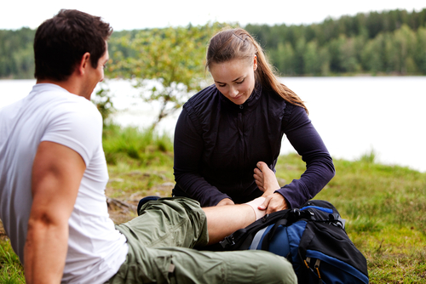
Long-Term Treatment
For puncture wounds involves:
  keeping the wound elevated as much as possible
  seeking physicians’ advice on whether a
  tetanus shot is necessary

Slide 31
Long-Term Treatment
For puncture wounds involves watching for infection
  can cause wound to release green or pale yellowish-green fluid known as pus
  may cause surrounding skin to become painful, red, swollen and irritated
  may produce red streaks on skin surrounding wound
    can be a sign of an infection in the lymphatic system and medical attention should be received immediately

Slide 32
Common Household Poisons
Include:
  medicines (prescription and non-prescription)
  cleaning products
  certain plants (indoor and outdoor)
  batteries
  bug and weed killer
  lighter fluid
  laundry products
  mouthwash
Keep these things in a locked cabinet or out of the reach of small children!

Slide 33
Types of Poisoning
Include:
  ingestion
    when someone swallows or eats a poisonous substance
  inhalation
    when someone breathes in a poisonous substance
  dermal exposure
    when poisonous substance is absorbed through skin
  ocular exposure
    when poisonous substance absorbed in eyes

Slide 34
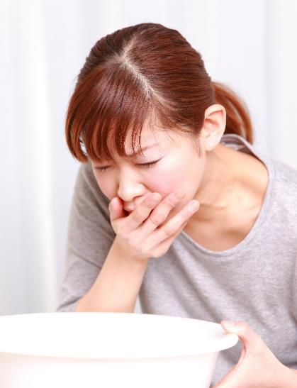
Identification of Poisoning
Requires looking for:
  burns or redness around
  the mouth and lips
  breath smelling like
  chemicals, such as
  gasoline or paint thinner
  vomiting
  difficulty breathing
  drowsiness
  confusion or other altered mental state

Slide 35
Assessing Poisoning
Involves calling 911 immediately if the person has collapsed and is not breathing
Requires finding and keeping the label of poisonous substance

Slide 36
Assessing Poisoning
Involves calling Poison Control or a medical professional and calmly reporting:
  victim’s condition, age and weight
  label, container and/or poisonous substance
  time the poisoning occurred
  your name and phone number

Slide 37
Immediate Treatment for Ingestion Poisoning
Involves following the directions of either the Poison Control Center or health care professional
National Hotline
1-800-222-1222

Slide 38

Immediate Treatment for Inhalation Poisoning
Involves immediately
finding fresh air
Requires opening doors
and windows
Involves following the
directions of either the
Poison Control Center
or health care professional

Slide 39
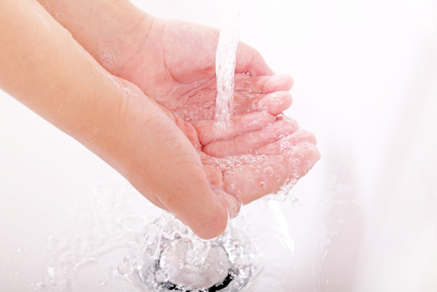
Immediate Treatment for Dermal Poisoning
Involves:
  removing affected clothing
  rinsing skin for 15 minutes with cool water
  following directions of either the Poison Control Center or health care professional

Slide 40
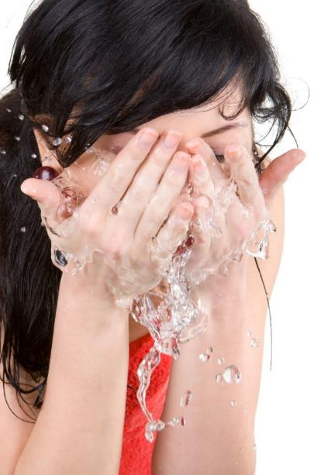
Immediate Treatment for Ocular Poisoning
Involves:
  immediately rinsing the
  eye with water for
  15 minutes
  blinking continuously
  not forcing the eyelid
  open
  following the directions
  of either the Poison
  Control Center or
  health care professional

Slide 41
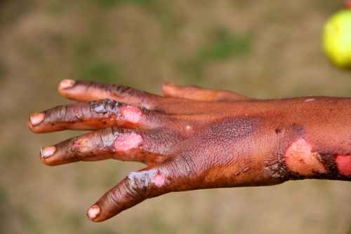
Types of Burns
Include:
  thermal burns
    caused by heat exposure
  chemical burns
    caused by skin contact with strong acids, alkalis or other corrosive materials

Slide 42
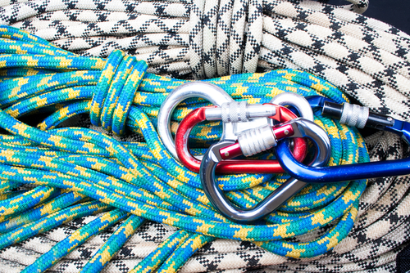
Types of Burns
Include:
  electrical burns
    caused when electrical currents travel into the body and are converted into heat
    can produce a contact burn on surface at point where current left the body
  mechanical burns
    caused by friction, such as rope burn or carpet burn

Slide 43
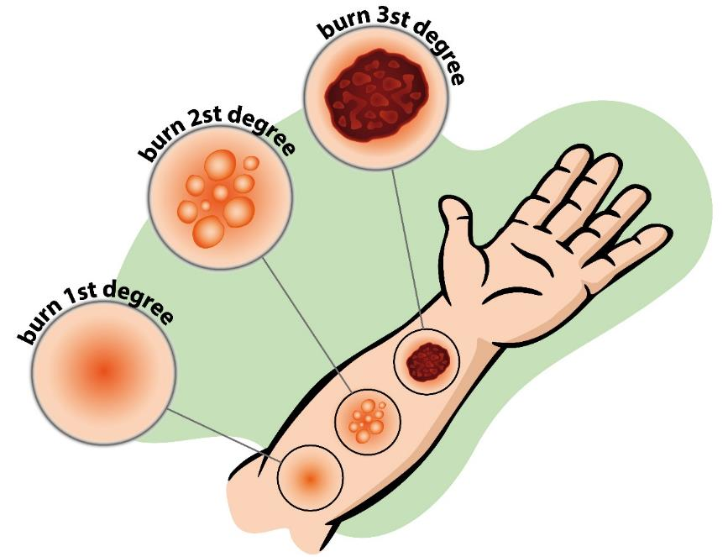
Severity of Burns
Is described in the following terms:
  first-degree burns
  second-degree burns
  third-degree burns

Slide 44
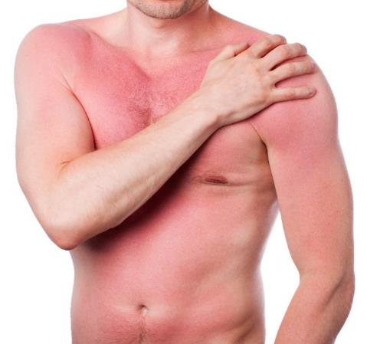
First-Degree Burns
Damage only the epidermis or top layer of skin
Include sunburns and short exposure to flame, steam or heat
Normally heal within a few days but are usually painful

Slide 45
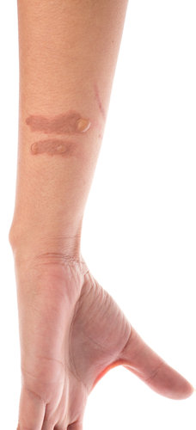
Second-Degree Burns
Affect the second layer of skin, known as the dermis
Cause skin to appear:
  moist and splotchy
  normally pink or red
  white to the touch
Blister
Are very painful

Slide 46
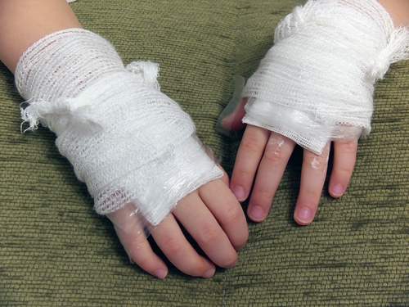
Third-Degree Burns
Destroy the epidermis and dermis and extend into subcutaneous layers, the deeper third layers of skin
Cause the skin to
appear white or black
Are usually not painful
because most of the
nerve endings have
been destroyed

Slide 47

Immediate Treatment
For first-degree thermal burns involves:
  applying a cold compress and aloe vera to the burn
    do not use butter or oils, which can cause additional damage to the skin
  taking acetaminophen if feverish

Slide 48

Immediate Treatment
For second-degree
thermal burns involves:
  dousing with cool
  water as soon as
  possible
    do not use butter,
    oils or ice, which can
    cause additional tissue damage
  seeking immediate medical attention if burn is larger than three inches

Slide 49
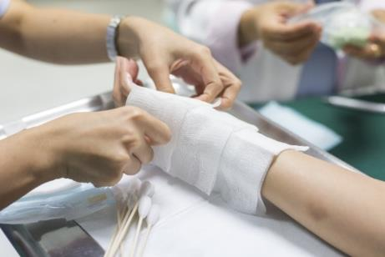
Immediate Treatment
For third-degree thermal burns involves:
  seeking immediate medical attention
    do not douse large severe burns with cold water because it can lower the body temperature too quickly and cause shock
    do not use butter, oils or ice, which can cause additional tissue damage

Slide 50
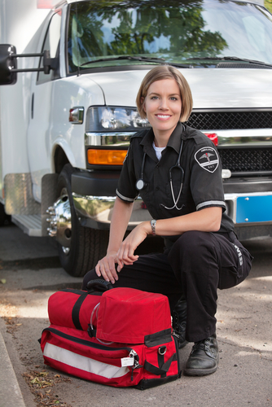
Immediate Treatment
For chemical burns
involves:
  rinsing affected area
  with plenty of water
  calling local poison
  control or health care
  professional for further
  instructions
For electrical burns involves:
  seeking professional medical attention immediately

Slide 51

Long-Term Treatment
For first-degree burns involves:
  staying hydrated
  applying aloe vera over affected area often
For second- and third-degree burns involves:
  following doctor’s orders

Slide 52
Bone & Joint Injuries
Can include
  dislocations
  sprains and strains
  fractures

Slide 53
Dislocations
Occur when the ends of bones are forced from their normal positions
Typically involve the body’s larger joints, such as the shoulders, hips or elbows
Temporarily immobilizes the joint, resulting in sudden severe pain and swelling
Require prompt medical attention

Slide 54
Assessing Dislocations
Requires:
  looking for visible deformation, discoloration or swelling
  asking if the victim is in pain or experiencing numbness or tingling
  checking to see if the joint will bend or move normally
    do NOT force joint to move if it will not

Slide 55
Immediate Treatment
For dislocated joints involves:
  immobilizing the joint in a fixed position
    do NOT try to force the joint back into place
  seeking medical attention immediately
  icing the injured joint to decrease swelling, internal bleeding and the build up of fluids around the joint

Slide 56
Long-Term Treatment
For dislocated joints involves:
  keeping joint immobilized and continuing cold therapy regularly for a few days
    until pain subsides
  performing mobility and strengthening exercises, provided there is no pain
    ice after exercise if swelling occurs
  avoiding recurrent dislocations
    by avoiding actions likely to cause injury
    if necessary, with surgery to repair internal damage and/or tighten lax ligaments and muscles

Slide 57
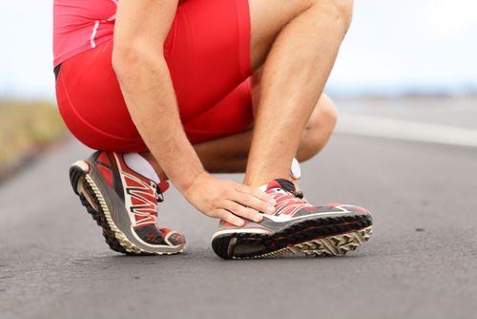
Sprains & Strains
Can be experienced at any time, such as when playing a sport or walking downstairs
  sprains occur when ligaments are overstretched and could be partly torn
  strains occur when muscles are overstretched

Slide 58
Assessing Sprains & Strains
Involves not attempting to move individual if head or neck is injured
Requires calling a doctor or immobilizing (prevent from moving) the injury and transporting the individual to the nearest emergency room
  it can be difficult to tell the difference between a sprain or strain and a broken bone without medical expertise

Slide 59
R.I.C.E.
Is an effective acronym for remembering first aid procedures for sprains and strains
  Rest the injury
  Ice the injury for a few minutes several times a day to reduce swelling
  Compress by keeping the injury wrapped to reduce the amount of swelling
  Elevate the injury above heart level
  to reduce swelling
Do not apply heat for a few days; it increases swelling of the injury

Slide 60
Long-Term Treatment for Sprains & Strains
Involves:
  staying off of injury as much as possible
  keeping the injury wrapped for a few days to give extra support and keep swelling down
As long as you take care of yourself and your injury, you should be back to normal in a few days to a few weeks.

Slide 61
Fractures
Refer to broken bones
Require immediate medical attention
  while waiting for medical attention one should perform the following:
    stop any bleeding by applying pressure to the wound with a sterile bandage
    immobilize injured area
    apply ice packs to help limit swelling and to relieve pain
First Aid Awareness: If the person who has fractured a bone begins to feel faint or experiences short, rapid breathing, the person should be laid down with their legs elevated higher than the rest of their body.

Slide 62
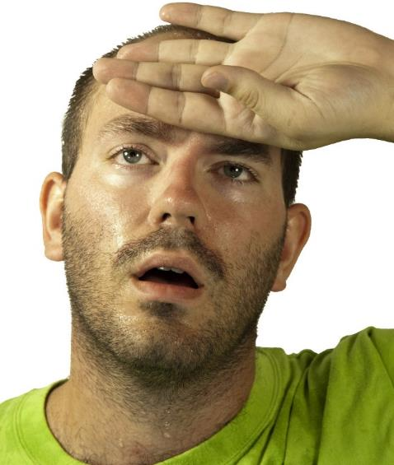
Heat Exhaustion
Is the most common form of heat-related injury
Symptoms include:
  moist, pale skin
  nausea
  headache
  dizziness
  weakness
  exhaustion

Slide 63
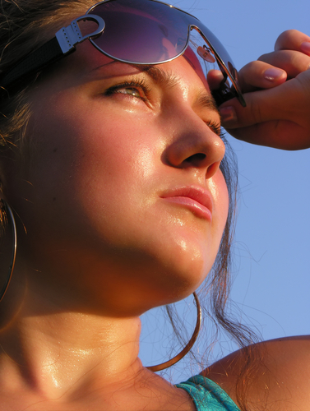
Heat Stroke
Is life threatening
Symptoms include:
  consciousness change
  high body temperature
  red, hot skin, which can
  be dry or moist
  pulse can be rapid or
  weak
  breathing is rapid and shallow

Slide 64
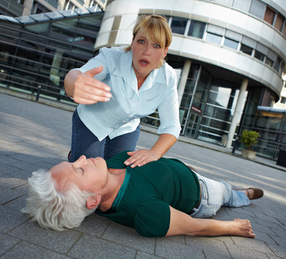
Immediate Treatment
For heat-related injuries involve:
  moving the victim to a cooler environment
  loosening and removing restricting clothing or any clothing
  intensifying the heat
  fanning the victim
  applying water
  allowing victim to
  sip small amounts
  of cool water

Slide 65
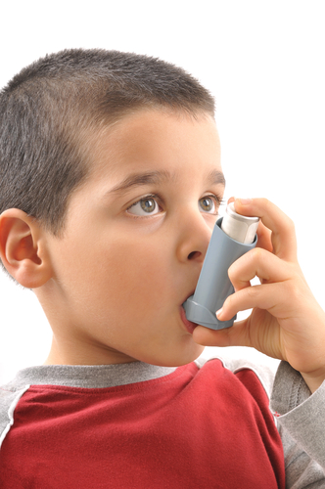
Allergic Reactions
Include:
  hay fever
  asthma
  allergic conjunctivitis
  eczema
  hives
  anaphylactic shock

Slide 66
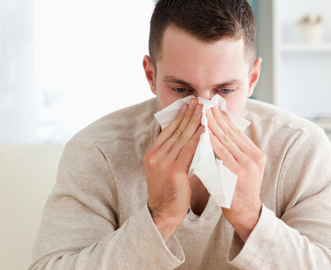
Hay Fever
Is the most common allergic reaction
Involves sneezing, coughing and watery eyes
Can be prevented by avoiding the allergens
Can be treated with antihistamines, decongestants or
nasal sprays to
lessen the severity

Slide 67
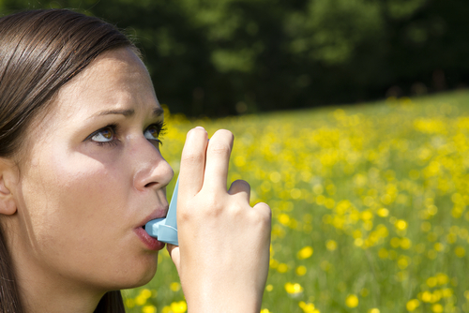
Asthma
Is a breathing problem caused by inflamed air passages in the lungs
Is a serious condition
  if a household member has asthma it is important to have an inhaler in the first aid kit for emergency situations

Slide 68
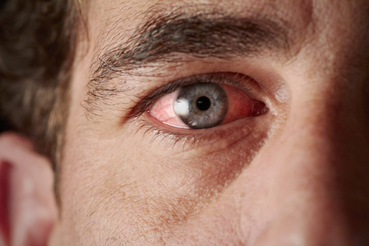
Allergic Conjunctivitis
Is not contagious
Is the inflammation of the eyeball tissue and undersurface of the eyelid
Can be alleviated by over-the-counter products like artificial tears to dilute the allergens in the eyes

Slide 69
Eczema
Is an inflammation of the epidermis, or outer layer of skin
Refers to a range of persistent skin conditions characterized by the following:
  redness, swelling, itching, dryness, crusting, flaking, blistering, cracking, oozing and bleeding

Slide 70
Eczema
Can be prevented by
avoiding items which
seem to irritate skin
Can be treated by
replenishing the skin
with moisturizers and
suppressing the
itching with topical
ointments and oral
antihistamines

Slide 71
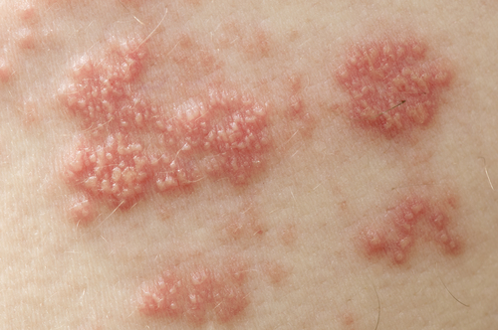
Hives
Are itchy swellings occurring anywhere on the body
Can be treated by the use of antihistamines

Slide 72
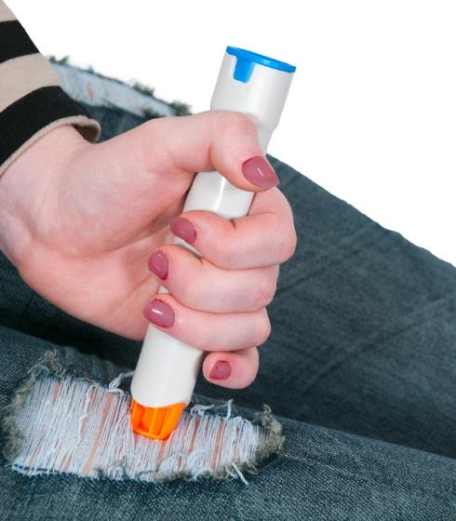
Anaphylactic Shock
Is a life-threatening allergic reaction which can affect numerous organs at one time
Usually occurs when
the allergen is eaten
(e.g., peanuts) or
injected (e.g., bee
sting)

Slide 73
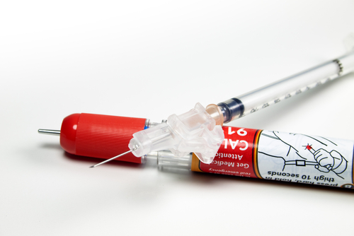
Anaphylactic Shock
Can be treated by immediately injecting epinephrine into the thigh and rubbing the site to improve drug absorption
Requires calling 911 or other emergency service when suspected

Slide 74
First Aid Basics – Emergency Responses

Slide 75
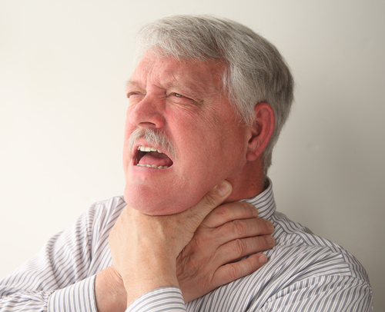
Choking
Is identified by any
of the following
signs:
  eyes bulging
  color of face turning
  bluish-purple from lack of oxygen
  person starting to wheeze or gasp
  for air
  person grabbing for or pointing to his/her throat

Slide 76
Assessing Choking
Requires checking to see if the person is able to talk or cough
  if so, the Heimlich maneuver is not necessary, just give the person air and allow them to recover
  if not, the Heimlich maneuver is necessary

Slide 77
The Heimlich Maneuver
Is used when objects (like food) have been lodged in the trachea or the tube used to breathe
Forces pressure quickly up through the trachea to dislodge object

Slide 78
Steps of the Heimlich Maneuver
Stand behind the victim, wrap your arms around his or her waist
Make a fist and place it slightly above the person’s navel
Grab fist with other hand and press hard into the abdomen with an upward thrust
Repeat procedure until object comes loose from the airway
If person becomes unconscious, perform CPR

Slide 79
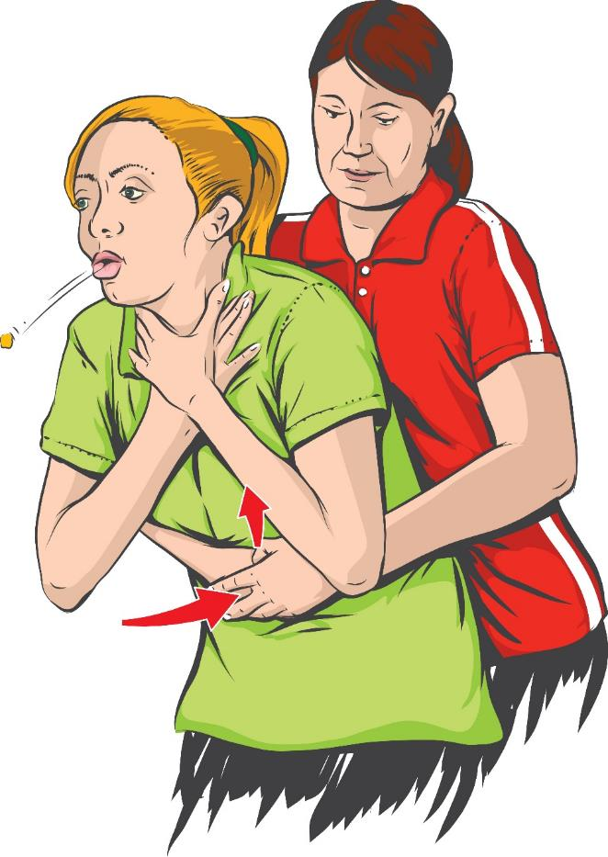
Heimlich Maneuver

Slide 80
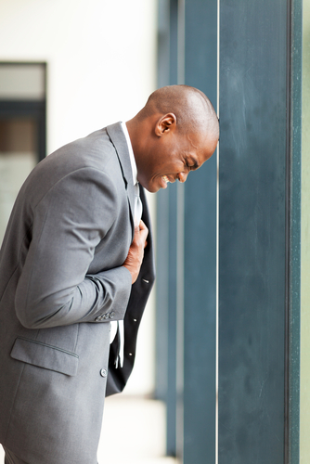
Heart Problems
Are identified through the
following signs and
symptoms:
  feelings of heart burn
  chest pain
  shortness of breath
  numbness
If you or someone around you is experiencing any of these signs or symptoms of heart problems, seek medical attention immediately.

Slide 81
Assessing Heart Problems
Requires seeking medical attention immediately
Involves determining whether or not the victim is unconscious
  if conscious, help the victim get medical attention, take prescribed heart medications and give them 300 mg of aspirin to chew and swallow
  if unconscious, check if the victim is breathing or has a pulse; if neither are present, begin CPR until medical teams have arrived

Slide 82
Cardiopulmonary Resuscitation
Is commonly referred to as CPR
Is a combination of mouth-to-mouth rescue breathing and chest compressions
Was put in practice in 1960 after several doctors discovered the benefit of chest compressions to artificially stimulate heart and generate a small amount of circulation

Slide 83
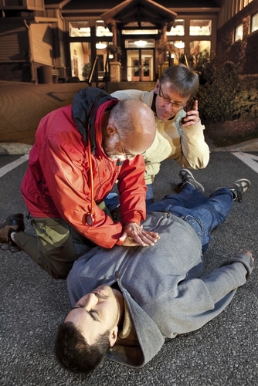
Steps of CPR
Check the victim by patting
and calling name
  if there is no response, call
  911 and return to victim
Lay the unconscious
person flat on his or her
back on a firm surface
Tilt head back and lift
the person’s chin forward
to open the airway

Slide 84
Steps of CPR
Check for breathing and a pulse
  check for pulse by pressing first two fingers under victim’s jawbone on side of neck near the jugular vein
  listen for breathing sounds close to the mouth while feeling for air motion on your cheek and looking for chest motion
  check every four cycles of 15 chest compressions for breathing and a pulse
If person is breathing, but there is no pulse, CPR is required. If person has pulse, but is not breathing, perform mouth-to-mouth breathing only, without compressions.

Slide 85
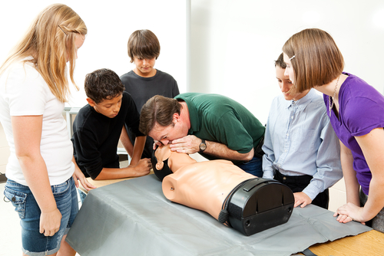
Steps of CPR
If person is not breathing, pinch nose closed, place your mouth firmly over victim’s mouth
Breathe gently into mouth twice, each breath should last two seconds and make sure to take a full breath each time

Slide 86
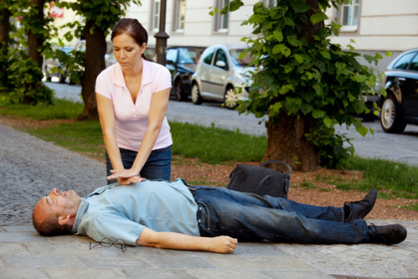
Steps of CPR
Check again for pulse
and breath signs;
if pulse is still not
present begin chest
compressions
  place palm of hand in middle of chest, press down 1 1/2 to 2 inches
  repeat this motion quickly 30 times (at 100 beats per minute or the beat of the chorus “Stayin’ Alive”); it is a good idea to count out loud to yourself

Slide 87
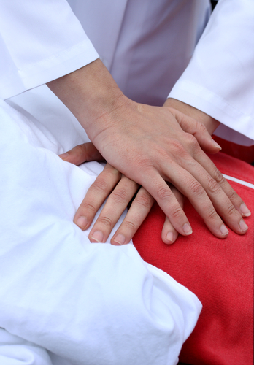
Steps of CPR
Give two more breaths
after the first set of
compressions
Continue this cycle of
30 compressions and
two breaths until help
arrives

Slide 88
Hands-Only™ CPR
Requires only the compression, not the mouth-to-mouth portion of CPR
Is more effective immediately after a victim collapses
  the victim still has oxygen in blood and it is better to start the heart first
Is not suitable for victims such as:
  children
  anyone found unconscious
  victims of drowning or problems with breathing

Slide 89
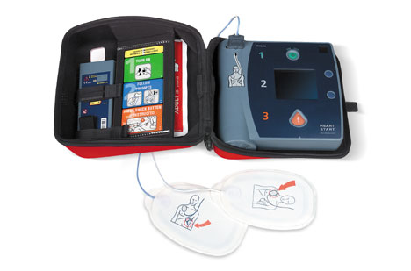
Automated External Defibrillators
Are about the size of a laptop computer and monitor a victim’s heart rhythms when small nodes are attached to the chest
Will inform the rescuer if an electric shock is necessary
and walk him or her
through the steps of
delivering the shock

Slide 90
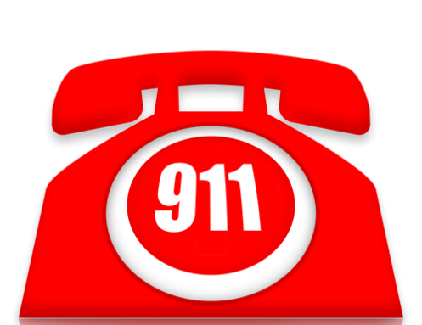
Sudden Illnesses
Include:
  strokes
  seizures
  diabetic emergencies
  allergic reactions
  poisonings
Often occur unexpectedly
Require calling 911 and seeking help immediately

Slide 91

Tips for Responding to Emergencies
Be prepared
  accidents can happen
  anywhere and at any
  time
  a quick response to
  an accident can give
  the victim a better
  chance at recovery

Slide 92
Tips for Responding to Emergencies
Stay calm and be sure to assess the situation
  do not get flustered or distracted
Follow the first aid steps and call for help
  even if the accident is not serious, or the hurt person does not need medical attention, it is always best to play it safe

Slide 93
Acknowledgments
www.kidshealth.org from the Nemours Foundation
http://survival.anomalies.net/emergenc.html Red Cross Emergency Handbook
www.aapcc.org American Association of Poison Control Centers
http://dets.washington.edu/learncpr Learn CPR website from the University of Washington School of Medicine

Slide 94
Acknowledgements
Production Coordinators
Whitney Orth
Megan O’Quinn
Allison Lee
Graphic Designer
Melody Rowell
Brand Manager
Megan O’Quinn
V.P. of Brand Management
Clayton Franklin
Executive Producer
Gordon W. Davis, Ph.D.
© MMXVI
CEV Multimedia, Ltd.

